Slide 1
Alleviating Energy Poverty in Germany
Best-Practice from across the EU
Viktoria Noka, Dr. Johanna Cludius, Dr. Katja Schumacher, Katja Hünecke
IEPPEC 2018
Vienna, 25th June
Hinweis zum Bildtausch:
Bild mit der Maus markieren, dann rechte Maustaste drücken und „Bild ändern“ wählen. Neues Bild auf dem Laufwerk auswählen und einfügen. Es wird nun an der Stelle des vorhandenen Bildes eingefügt und kann/muss dann noch etwas in der Größe verändert werden.
The contents of this report are based on research conducted in the framework of the project “Perspectives of citizen participation in Germany’s energy transition taking into account distributional issues” on behalf of the German Federal Ministry of Education and Research.

Slide 2
Agenda
Collection & Categorization
Hinweis Aktualisierung der Nummerierung:
Der aktive Agendapunkt ist blau (RGB 0/106/164 und der inaktive ist grün (RGB 151/191/13).
Bitte jeweils umfärben. Die Farben sind im Master hinterlegt oder einfach mit der Funktion „Format übertragen“ kopieren
1
Policy Assessment & Transfer
2
Impact Analysis
3

Slide 3
Policy Instruments and Measures
Direct Financial Support
Winter Fuel Payment – UK
Transfer Payments – Germany
Energy Efficiency Measures
Habiter Mieux – France
Information and Guidance Schemes
Charity & NGO – UK and Ireland
Other Measures
Disconnection Safeguards – UK and Denmark
Pay-as-you-go Meter – UK

Slide 4
Agenda
Collection & Categorization
Hinweis Aktualisierung der Nummerierung:
Der aktive Agendapunkt ist blau (RGB 0/106/164 und der inaktive ist grün (RGB 151/191/13).
Bitte jeweils umfärben. Die Farben sind im Master hinterlegt oder einfach mit der Funktion „Format übertragen“ kopieren
1
Policy Assessment & Transfer
2
Impact Analysis
3

Slide 5
Best-Practice Examples
Selected best-practice examples | Empirical examples | Why was this example selected? | Prevailing limitations | Transferability to the Germ an context
Direct financial support
Reimbursement of heating costs | - Household Benefit Package for people over 70 (Ireland) - Heating costs reimbursement for households on small pensions (Denmark) | - Target group well defined -Extends direct and continuing support to additional vulnerable groups | - Does not address causes of energy poverty -Does not contribute to long-term climate goals | Hybridization of the current German reimbursement system (with the Irish and Danish systems)
Support for energy efficiency measures
Support for renovation measures for homeowners with low income or little savings | - Habiter Mieux, social funds for thermal energy renovation (France) - Warmth and Wellbeing (Ireland) - Affordable Warmth Grants (UK) | - Targeted - Sustainably addresses one of the causes of energy poverty - Contributes to overall climate goals - Often implemented locally | - Depending on design, access to capital may still be an issue - Not likely to incentivize deep renovations - Rent may rise due to deep renovations | Adaptation of Irish, French, and English examples

Slide 6
Best-Practice Examples
Selected best-practice examples | Empirical examples | Why was this example selected? | Prevailing limitations | Transferability to the German context
Information and guidance schemes
Information on energy saving measures | - Keep Well and Warm and The Warm Charity information programme (Ireland) - Secours Catholique and EDF (France) | - Targeted - Often local and peer-to-peer - Has the potential to reduce energy consumption in the long term | - Financial barriers to implementation of measures may remain | Already exists in Germany, can learn from implementation in other countries
Other Measures
Consumer protection against power cut-offs | - Energy Safety Net (UK) - Winter Truce Program (France) - Legislative provisions in Denmark and Sweden | - Targeted - Provides immediate support and avoids exacerbating problems | - Does not sustainably address causes of energy poverty or reduce energy consumption in the long term -Does not contribute to long-term climate goals | Some provisions already in place in Germany, can learn from implementation in other countries

Slide 7
Agenda
Collection & Categorization
Hinweis Aktualisierung der Nummerierung:
Der aktive Agendapunkt ist blau (RGB 0/106/164 und der inaktive ist grün (RGB 151/191/13).
Bitte jeweils umfärben. Die Farben sind im Master hinterlegt oder einfach mit der Funktion „Format übertragen“ kopieren
1
Policy Assessment & Transfer
2
Impact Analysis
3

Slide 8
Scenario 1 – Heating Cost Reimbursments
Danish Model
Households on small pensions
Irish Houshold Benefit Package
Households where head of household is 70 or older

Slide 9
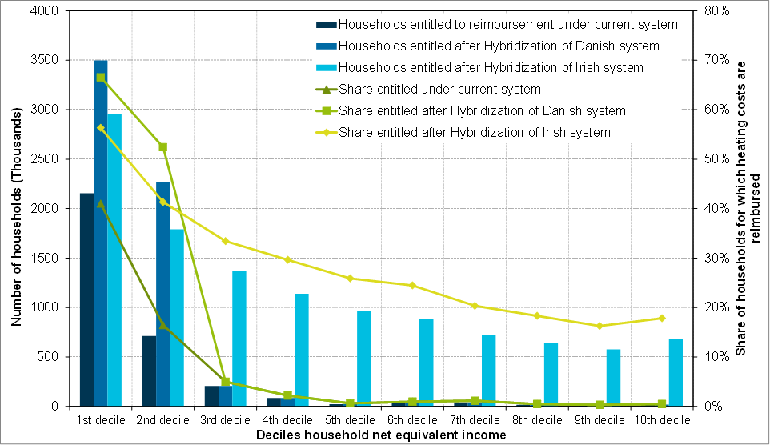
Scenario 1 – Heating Cost Reimbursments
Source: Research Data Centre (FDZ) of the federal statistical office and statistical offices of the Laender: Income and Expenditure Survey 2013 (EVS 2013); own estimation and illustration

Slide 10
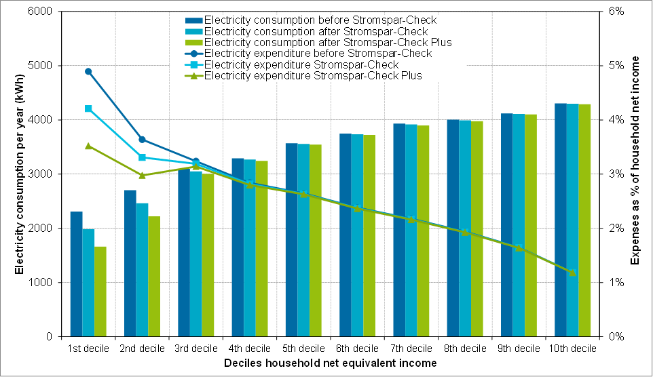
Scenario 2 – Electricity Saving Check
Source: Research Data Centre (FDZ) of the federal statistical office and statistical offices of the Laender: Income and Expenditure Survey 2013 (EVS 2013); own estimation and illustration

Slide 11
Conclusions
Landlord/
Tenant
Low-Income Households
Social Policy
Long-Term
Local/
Regional/
Peer-to-Peer
Financial & Informative

Slide 12
‘It is important for social policy to develop alongside energy and climate policy and, conversely, for energy and climate policy to be designed in a socially compatible manner’

Slide 13
Thank you for your attention! Vielen Dank für Ihre Aufmerksamkeit!
?
Do you have any questions? Haben Sie noch Fragen?

Slide 14
Ihre Ansprechpartner
Johanna Cludius
Öko-Institut e.V.
Büro Berlin
Schicklerstraße 5-7
10179 Berlin
Telefon: +49 30 405085-375
E-Mail: j.cludius@oeko.de
Viktoria Noka
Öko-Institut e.V.
Büro Berlin
Schicklerstraße 5-7
10179 Berlin
Telefon +49 30 405085-380
E-Mail: v.noka@oeko.de

